Slide 1
Unit-2 First Half: Understanding Your Data Using R, explores the idea of adding context to the big data you are working on with R. Second Half: Addressing Big Data Quality, talks about categorized data quality and the Challenges big data brings to them. In addition, examples demonstrating concepts for effectively addressing these areas are covered

Slide 2
Understanding Your Data Using R
In this session we will explore the idea of adding context to the data you are working with
We’ll discuss the importance of establishing data context, as well as the practice of profiling your data for context discovery and how big data affects this effort
Bigdata sources have the potential to positively impact your marketing efforts, profitability, decision making, or even your life, there also exists the risk of drawing incorrect conclusions from that same data

Slide 3
There are several contextual visualization categories, which can be used to augment or increase the value and understanding of data for visualization. These include the following:
Definitions and explanations
Comparisons
Contrasts
Tendencies
Dispersion

Slide 4
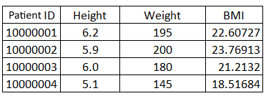
Definitions and explanations
This is providing additional information or attributes about a data point.

Slide 5
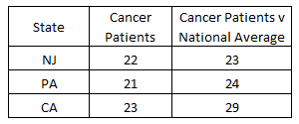
Comparisons
This is adding a comparable value to a particular data point. For example, you might
compute and add a national ranking to each total by state:

Slide 6
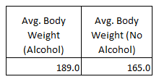
Contrasts
This is almost like adding an opposite to a data point to see if it perhaps determines a different perspective
An example might be reviewing average body weights for patients
who consume alcoholic beverages versus those who do not consume alcoholic beverages:

Slide 7
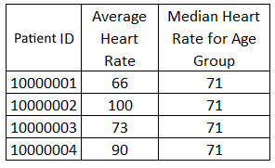
Tendencies
These are the typical mathematical calculations (or summaries) on the data as a whole or by
other categories within the data, such as mean, median, and mode.
For example, you might add a Median Heart Rate for Age Group that each patient in the data is a member of:

Slide 8
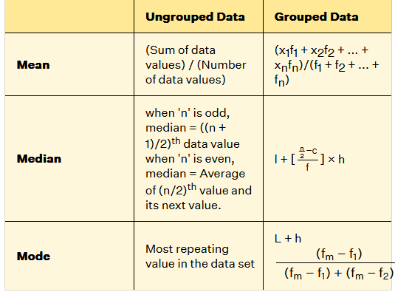
Mean Median Mode Formula
The mean median mode formula helps us to find the measures of central tendency. The mean, median, and mode for grouped and ungrouped data are calculated by the formulas below:

Slide 9
Dispersion
Again, these are mathematical calculations (or summaries), such as range, variance, and standard deviation
But they describe the average of a dataset (or group within the data).
For example, you may want to add the range to a selected value such as the minimum and a maximum number of hospital stays found in the data for each patient age group:

Slide 10
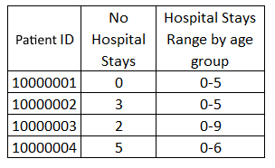
Dispersion (Con.)

Slide 11
Dispersion (Con..)
The art of profiling data to add context and identify new and interesting perspectives for visualization is still and ever evolving
no doubt there are additional contextual categories existing today
That can be investigated as you continue your work with big data visualization projects.

Slide 12
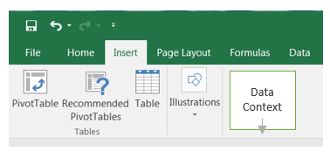
Adding context
So, how do we add context to data? Is it merely select Insert, then Data Context?
No, it's not that easy (but it's not impossible either)

Slide 13
Once you have identified (or pulled together) your big data source (or at least a significant amount of data)
how do you go from mountains of raw big data to summarizations that can be used as input to create valuable data visualizations, helping you to further analyze that data and support your conclusions?
The answer is through data profiling.

Slide 14
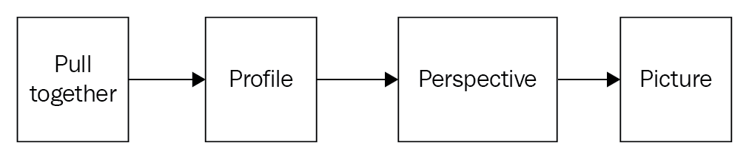
Data profiling involves logically getting to know the data you think you may want to visualize through query, experimentation, and review.
Adding context to data requires the manipulation of data to perhaps reformat, adding calculations, aggregations, or additional columns or re-ordering, and so on.
Complete profiling process is as follows:
Pull together the data or enough of the data.
Profile the data through query, experimentation, and review.
Add Perspective(s) or context.
Picture (visualize) the data.

Slide 15
About R
R is a language and environment easy to learn, very flexible in nature,
also very focused on statistical computing thus making it great for manipulating, cleaning, summarizing, producing probability statistics, and so on (as well as actually creating visualizations with your data),
so it's a great choice for the exercises required for profiling,
establishing context, and identifying additional perspectives.

Slide 16
Few More reasons to use R when profiling your big data
R is used by a large number of academic statisticians, so it's a tool that is not going away.
R is pretty much platform-independent, what you develop will run almost anywhere.
R has awesome help resources–just Google it; you'll see!
R is free (open sourced), super flexible, and feature-rich
R libraries have been developed and introduced that can leverage hard drive space (as sort of a virtual extension of your machine's memory)

Slide 17
R Programming Basics
Kindly Click below link to Learn R Programming basics
https://www.geeksforgeeks.org/r-tutorial/

Slide 18
R and big data
You must keep in mind that R preserves everything in your machine's memory and this can become problematic when you are working with big data
Thankfully, there are various options and strategies to work with this limitation,
such as imploring a sort of pseudo-sampling technique
Additionally, R libraries have been developed and introduced that can leverage hard drive space (as sort of a virtual extension of your machine's memory)

Slide 19
Example 1
Defining new data points based upon the existing data, performing comparisons, looking at contrasts (between data points), identifying tendencies, and using dispersions to establish the variability of the data.
upon admission, information about a patient's medical history is collected through an online survey
Information is also added to a patient's file as treatment is provided.
Patient’s basic data – sex, DOBMonth, DOBDay, DOBYear
Vital statistics – blood_pressure, heartrate
Medical history – no_hospital_visits, surgeries, Major illness or conditions, Whether currently under a doctor's care
Demographical statistics – Occupation, Home state, Educational background
others like or Additional Information – inclusion of beef, pork, fowl, butter in diet

Slide 20
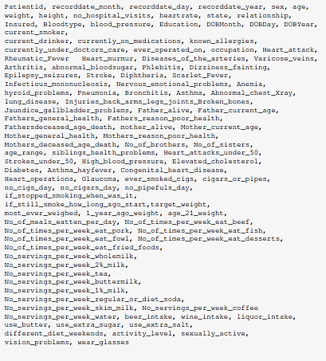

Slide 21
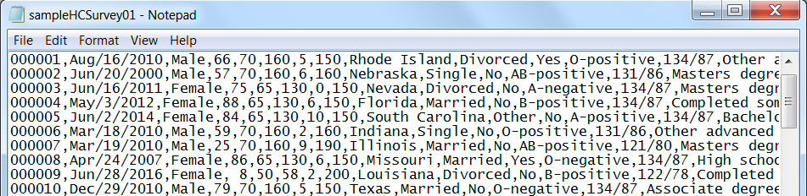
Screenshot showing a portion of the file (displayed in MS Windows Notepad):

Slide 22
How to proceed
Can we start grouping the data using fields such as sex, age, and state?
what we should be asking is, what can we learn from visualizing the data?
What is the breakdown of those currently smoking by age group?
What is the ratio of those currently smoking to the number of hospital visits?
Do the patients currently under a doctor's care, on an average, have better BMI ratios?

Slide 23
Digging in with R
Using the power of R programming, we can run various queries on the data.
If noting that the results of these queries may spawn additional questions and queries and eventually, yield data ready for visualizing

Slide 24
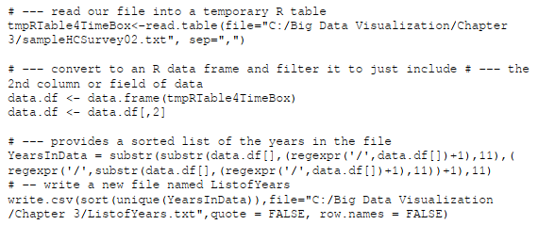
Let's start with a few simple profile queries. I always start my data profiling by time boxing the data.

Slide 25
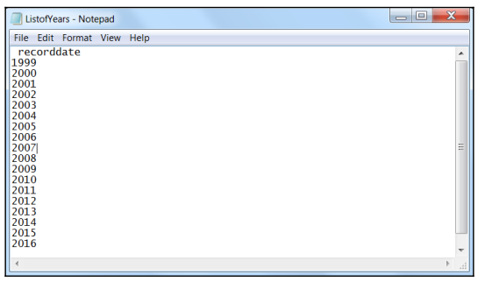
The preceding simple R script provides a sorted list file (ListofYears.txt shown in the following screenshot) containing the years found in the data we are profiling:
Now we can see that our patient survey data covers patient survey data collected during the years 1999 through 2016 and with this information, we start to add context (or allow us to gain a perspective) on our data
We could further time-box the data by perhaps breaking the years into months

Slide 26
Simple R functions that are valuable to know are nrow and head. These simple commands can be used to count the total rows in a file:
To view the first n number of rows of data, use the following code:

Slide 27
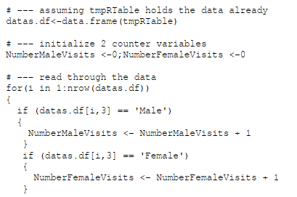

write a R script to load the data into a table, convert it to a data frame, and then read through all the records in the file and count up or tally the number of hospital visits (the number of records) for males and females

Slide 28
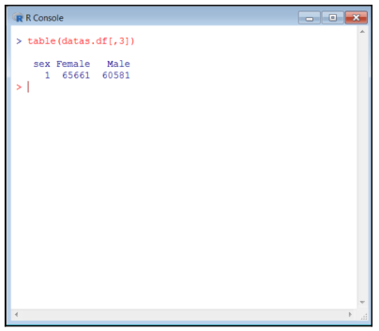

The following script assumes that our data is already in an R data frame (named datas.df), so using the sequence number of the field in the file, if we want to see the number of hospital visits for males and the number of hospital visits for females, we can
write the following:

Slide 29

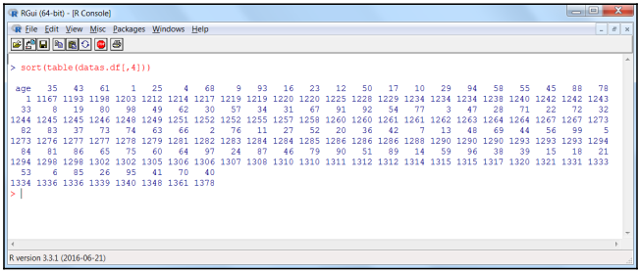
Age (or the fourth field in the file) can also be studied using the R functions Sort and table:

Slide 30
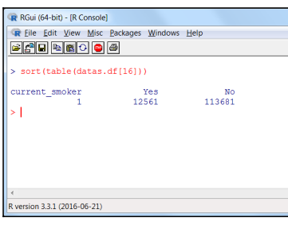

let's see if there is a difference between the number of hospital visits for patients who are current smokers (field name current_smoker and is field number 16 in the file) and those indicating that they are noncurrent smokers.

Slide 31
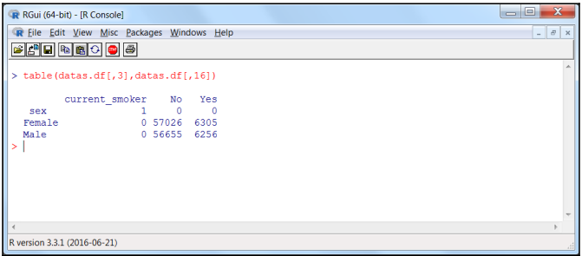
Another interesting R script to continue profiling our data might be:
The preceding script again uses the R table function to group data, but shows how we can group within a group, in other words, using this script we can get totals for current and noncurrent smokers, grouped by sex.

Slide 32
we've been able to add some context to our healthcare survey data.
By reviewing the list of fields provided in the file, we can come up with the R profiling queries shown (and many others) without much effort

Slide 33
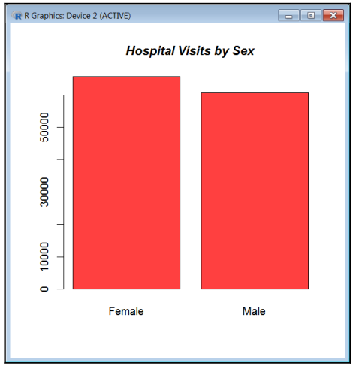
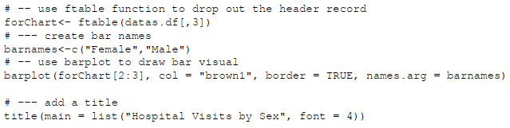
let’s use R to create a few data visualizations based upon what we've learned so far through our profiling
The number of hospital visits by sex, We can use the R function barplot to a visualisation of visits by sex.

Slide 34

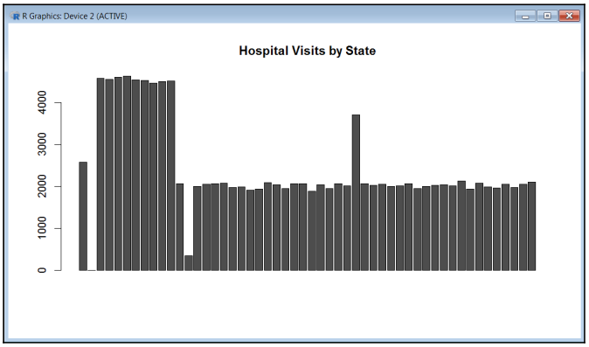
The same logic for creating a similar visualization of hospital visits by state

Slide 35
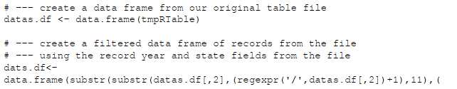
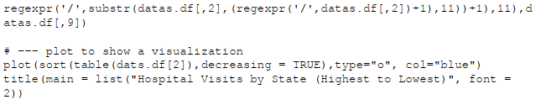
Using the R functions substr and regexpr, we can create an R data frame that contains a record for each Hospital Visits by State within each year in the file. Then we can use the function plot (rather than the barplot function) to generate the visualization

Slide 36
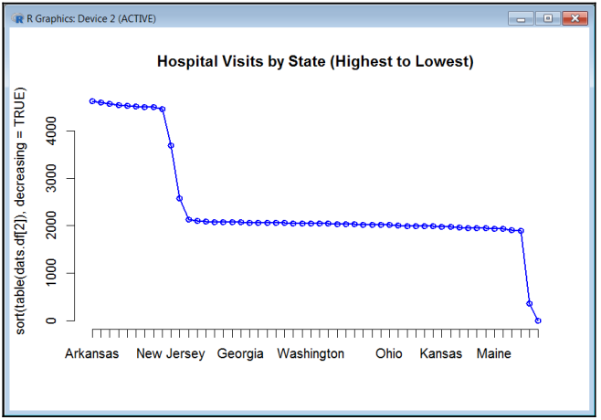
Output

Slide 37
Another earlier perspective on the data was concerning Age. We grouped the hospital visits by the age of the patients (using the R table function). Since there are many different patient ages, a common practice is to establish age ranges, such as the following: 21 and under 22 to 34 35 to 44 45 to 54 55 to 64 65 and over

Slide 38
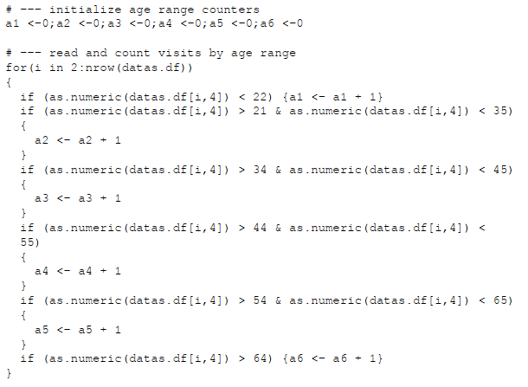

Slide 39

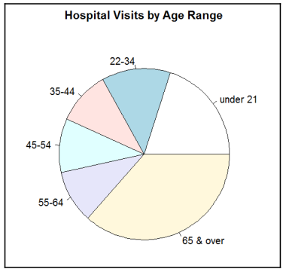

Slide 40
Example – 2 (Continue with the same data Set)
Defining new data points based upon the existing data, performing comparisons, looking at contrasts (between data points), identifying tendencies, and using dispersions to establish the variability of the data.
Let's now review some of these options for extended profiling using simple examples as well as the same source data that was used in the previous section examples.

Slide 41
Definitions and explanations
One method of extending your data profiling is to add to the existing data by creating additional definition or explanatory attributes (in other words, add new fields to the file).
This means that you use existing data points found in the data to create (hopefully new and interesting) perspectives on the data.

Slide 42
Definitions and explanations (Con..)
To use the existing patient information (such as the patient's weight and height) to calculate a new point of data: Body Mass Index (BMI) information.
A generally accepted formula for calculating a patient's body mass index is:
BMI = (Weight (lbs.) / (Height (in))2) x 703
Consider this example: (165 lbs.) / (702) x 703 = 23.67 BMI

Slide 43
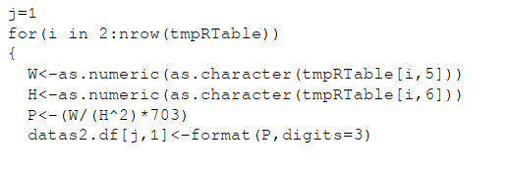
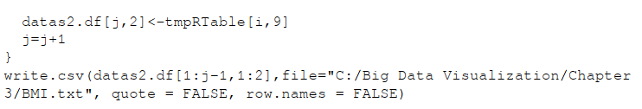
Definitions and explanations (Con..)
we've already loaded the R object named tmpRTable with our file data.

Slide 44
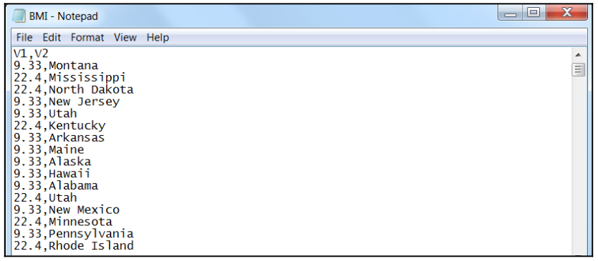
Output

Slide 45
No looping
The concept of looping or reading through all of the records in a file or data source and creating counts based on various field or column values.
Such logic works fine for medium or smaller files, but a much better approach (especially with big data files) would be to use the power of various R commands.
The R script described earlier does work, it requires looping through each record in our file, which is slow and inefficient, to say the least.

Slide 46
No looping
we've already loaded the R object named tmpRTable with our data, the following R script can accomplish the same results (create the same file) in just two lines:

Slide 47
Comparisons
Performing comparisons during data profiling can also add new and different perspectives to the data.
Beyond simple record counts (such as total smoking patients visiting a hospital versus the total non-smoking patients visiting a hospital) one might ponder to compare the total number of hospital visits for each state to the average number of hospital visits for a state.
This would require calculating the total number of hospital visits by state as well as the total number of hospital visits overall (then computing the average).

Slide 48
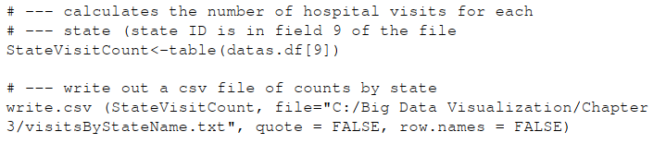
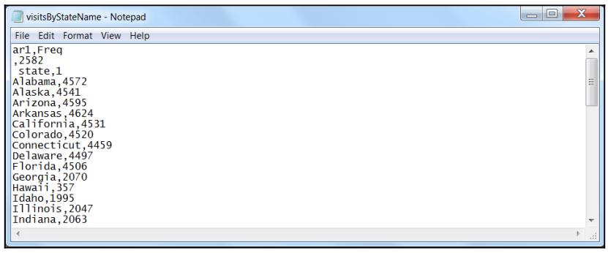
The two lines of code use the R functions table and write.csv to create a list (a file) of the total number of hospital visits found for each state.

Slide 49

To calculate the average number of hospitals by using the nrow function to obtain a count of records in the data source and then divide it by the number of states:

Slide 50
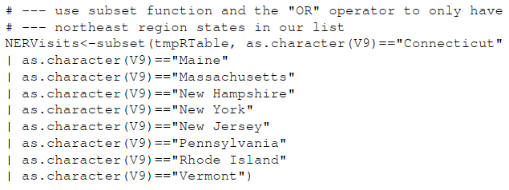
Going a bit further with this line of thinking, you might consider that the nine states the U.S. Census Bureau designates as the Northeast region are Connecticut, Maine, Massachusetts, New Hampshire, New York, New Jersey, Pennsylvania, Rhode Island, and Vermont. What is the total number of hospital visits recorded in our file for the northeast region?

Slide 51

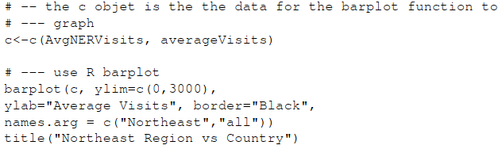
we can add some additional queries to calculate the average number of hospital visits for the northeast region and the total country:
And let's add a visualization

Slide 52
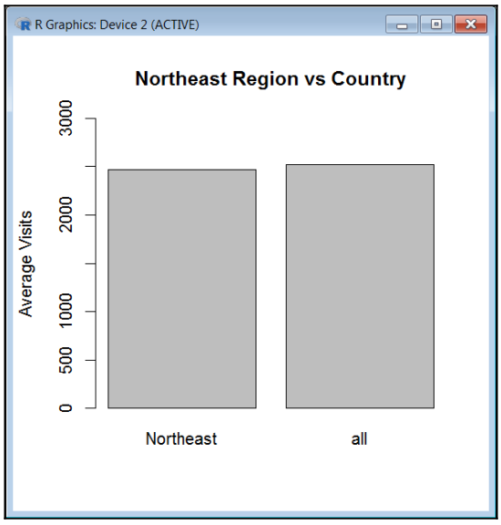

Slide 53
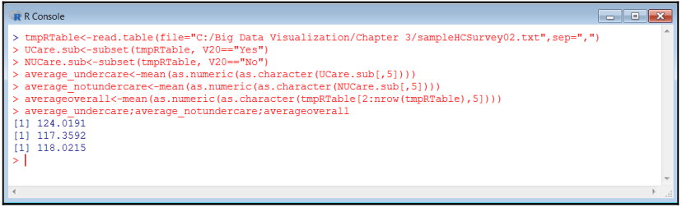
Contrasts - The examination of contrasting data is another form of extending data profiling
calculate the average weights for patients that fall into each category (those currently under a doctor's care and those not currently under a doctor’s care) as well as for all patients, using the following R script

Slide 54
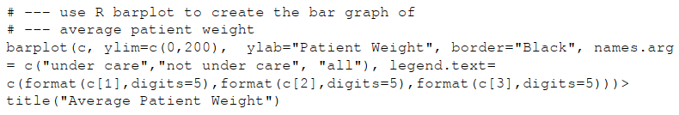
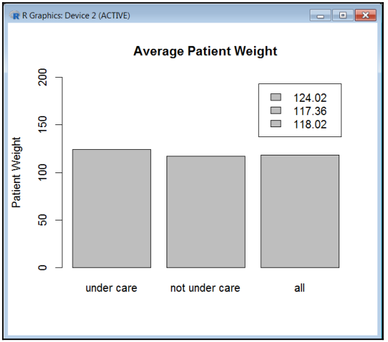

Slide 55
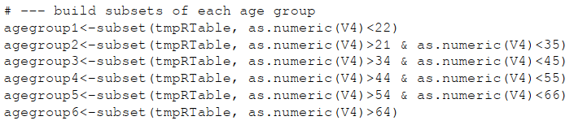
Tendencies - Identifying tendencies present within your data is also an interesting way of extending data profiling.
For example, using sample data, you might determine what the number of servings of water that was consumed per week by each patient age group.

Slide 56
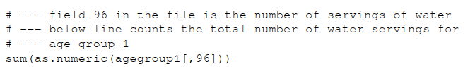

After we have our grouped data, we can calculate water consumption. For example, to count the total weekly servings of water (which is in field or column 96) for age group 1, we can use:
Alternatively, to calculate the average number of servings of water for the same age group

Slide 57
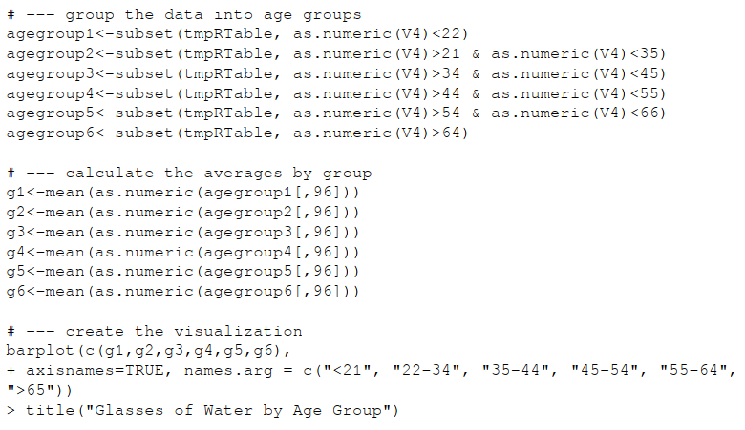
let's create the visualization of this perspective of our data

Slide 58
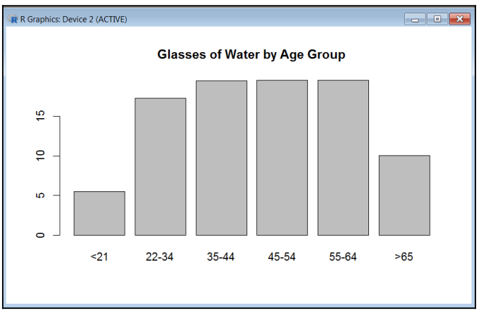
Output

Slide 59
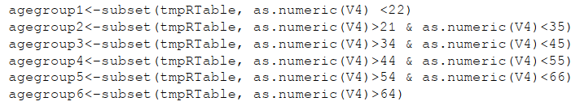
Dispersion - is still another method of extended data profiling
Dispersion measures how various elements selected behave with regards to some sort of central tendency, usually the mean.
For example, we might look at the total number of hospital visits for each age group, per calendar month in regards to the average number of hospital visits per month.

Slide 60
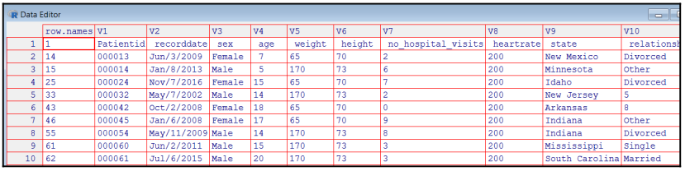
The preceding scripts create subsets of the entire file (which we loaded into the tmpRTable object ) and they contain all of the fields of the entire file.
Once we have our data categorized by age group (agegroup1 through agegroup6), we can then go on and calculate a count of hospital stays by month for each group (shown in the following R commands).
Note that the substr function is used to look at the month code (the first three characters of the record date) in the file since we (for now) don't care about the year.

Slide 61
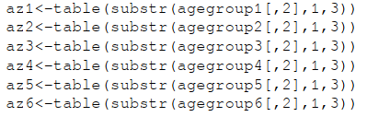
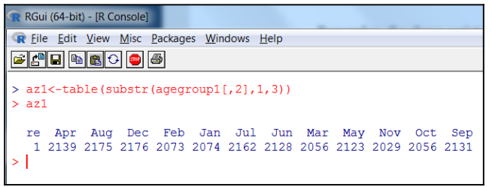
The table function can then be used to create an array of counts by month:

Slide 62

Using the preceding month totals, we can then calculate an average number of hospital visits for each month using the mean R function .
This will be the mean of the total for the month for ALL age groups:
Next we can calculate the totals for each month, for each age group:

Slide 63
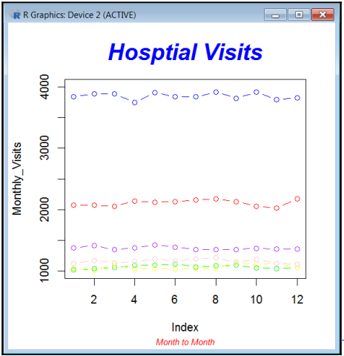
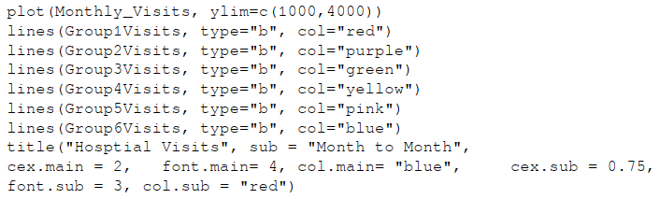
we can now create the visualization

Slide 64
Summary
we went over the idea and importance of establishing context and perhaps identifying perspectives to big data, using the data profiling with R.
Introduced and explored the R programming language as an effective means to profiling big data and used R in numerous illustrative examples.
Once again, R is an extremely flexible and powerful tool that works well for data profiling and the reader would be well served researching and experimenting with the languages and vast libraries available today, as we have only scratched the surface of the features currently available.

Slide 65
Addressing Big Data Quality ( Second Half)
We will talk about the categories of categorized data quality and the challenges big data brings to them.
To make programming a bit easier, programming languages categorize data into types or a datatype.
These categories of data are a defined kind or a set of possible values allowed by the type and allow progress to be made or, specifically, solutions to be crafted. Topics going to see in the Second Half
Data quality categorized
Data Manager
Data Manager and big data
Some examples
More examples

Slide 66
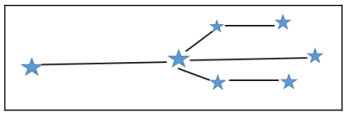
Data quality categorized
Garbage In Garbage Out (GIGO) was popular and well-known. The quality of data processed by computers (or used to create data visualisations) is not guaranteed.
If your data is wrong, your results will be wrong
Imagine what it might look like when using incorrect data points:
Data quality is relative as the level of accurateness or completeness is relative to or relates closely to the intended use of the data

Slide 67
We came across a file of patient survey information (consider examples in first Half), which contained over 105 fields or columns. In all of the various examples given, none required using all of these columns.
When evaluating the level of data quality, keep in mind that it is not always necessary for all columns in a file to have values in the (completeness)
Time-varying datasets can be tricky for example- Stock Market, weather Tracking)
“The level of data quality can be affected by the way it is entered, stored, and managed and the process of addressing data quality requires a routine and regular review and evaluation of the data…”.

Slide 68
The most general categories of data quality
Accuracy - data inaccuracies (e.g. - poor math, out of range, invalid values, duplication, and more
Completeness - missing values from particular columns, missing entire columns, or even complete transactions.
Update status - updating as well as have the ability to determine when the data was last saved or updated. It’s referred to as latency.
Relevance - This involves identification and elimination of information that you don't need or care about, given your objectives.
Consistency - It's common to have to cross-reference or translate information across data sources.

Slide 69
The most general categories of data quality (con..)
Reliability – The data assurance process involves establishing baselines and ranges and then routinely verifying that data results fall within established expectations.
Appropriateness - Data is considered appropriate if it is suitable for the intended purpose.
Accessibility - Data of interest may be watered down in a sea of data you are not interested in, thereby reducing the quality of the interesting data since it is mostly inaccessible.

Slide 70
Data Manager
Data Manager reads from and writes to delimitated files (comma-separated or CSV files) but also supports reading from various Open Database Connectivity (ODBC) data sources for greater flexibility
You can use Data Manager to create very straightforward designs or very complicated designs (using hundreds of nodes and multiple Inputs and Output nodes).
Node functionalities available in Data Manager include appending, deriving, distinction, fill, filter, merge, sample, select, and sort. Output options include distribution, histogram, database (DB), ODBC, quality, statistics, table, and XY plotting. In addition, you can execute external commands and leverage the power of Visual Basic Script (VBScript)

Slide 71
Data Manager and big data
Data Manager can handle very large datasets or files, it is comparable to most tools of its type, in that, when it comes to big data, it has essentially constrained your machine resources–processor speed, memory, and storage space.
Some of the big data challenges can be addressed outside of the tool but you can also be successful through leveraging features and functionalities within Data Manager.

Slide 72
Example working on Datamanager Tool
Referee to the Book “Designing Data Visualizations”, by Noah Iliinsky and Julie Steele.
Page No: 110 to 140.

